Slide 1
3D Game engine Programming
Neil Gannon 2016

Slide 2
Overview
Content Pipeline
3D Models
Creating
Loading
Updating
Drawing

Slide 3
Content Pipeline (CP)
The CP is easily the most powerful part of MonoGame
3D content is typically not “game ready” when exported from a 3D editor
.OBJ, .STL, .FBX, .X
All custom formats with varying information and structure
There is a need to convert this data before we can use it in our game
The CP is responsible for this conversion
The CP
Takes various input files (Images, Audio, Models, Custom Formats)
Processes them into specific data types (Texture2D, SoundEffect, Model)
Compiles them into a common format to be loaded into a game (.XNB)

Slide 4
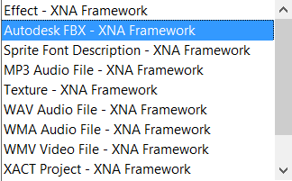
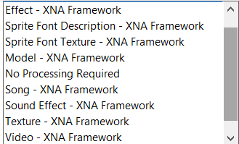
Content Pipeline Components
The CP has numerous components that are used to convert our input data into an XNB
Content Importer
Reads data from a file
If there is additional data that is does not know, it is ignored
Content Readers, Writers
Content DOM
Stores read data into strongly types objects
Content Processor
Any changes to the content can be done here
Content Compiler
Final stage, detects any errors in the previous steps, VS will display these
Outputs XNB file

Slide 5
Content Pipeline
When the content compiler notifies us of errors
Happens before the game is running
Build time error detection
Can be difficult to debug
Only compiles content when it changes
Smart enough to detect this
Not wasting build time
Error handling in content processors can be difficult
Because it’s build time, part of MSBUILD
Workarounds (Start another VS instance via code, Debugger.Lanuch())

Slide 6
MonoGame and Content References
An important note
When you load a piece of content into your game, MonoGame keeps track of this behind the scenes
If we have one cube model and we load it in 100 places throughout our code
The model will only ever be loaded once
These other loads will point to first one via a reference
If we manually change the data in the first instance then all other references will change too
We do no want this
We can copy this data locally and avoid issues later

Slide 7
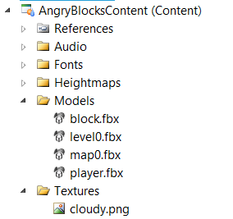
3D Models
The MonoGame Framework natively supports the loading of the following formats
.X (DirectX, discontinued)
.FBX (Autodesk, format of choice)
Other Importers and Processors exist online
OBJ
STL
We can add 3D models like any other content type to our solution via the content project

Slide 8
Model

Slide 9
Model Type
The MonoGame Framework provides a Model data type that encapsulates all the basic features of a 3D model
Vertex data
Index data
Primitive Shapes (TriangleStrip)
Effect to be used
Model Bones
We will use this throughout the semester
Found in Microsoft.Xna.Framework.Graphics

Slide 10
Model Structure
Model
ModelMesh
ModelMeshPart
Vertices
Indices
Effect
ParentBone
ModelBoneCollection

Slide 11
Bones
A model is composed of a collection of meshes
Each mesh has a bone
This bone has transformation data that was exported from the 3D modelling tool
Each is a Matrix
When drawing the model
We need to transform each bone by the World Matrix
Can also use this for manual animations

Slide 12

Bones
When we load our model in
We want to store the bone transforms locally
Allows manual animations without side effects
Most samples do this in the draw method
Not suitable for manual animations
The CopyAbsoluteBoneTransformsTo
Copies from BoneCollection to Matrix Array

Slide 13
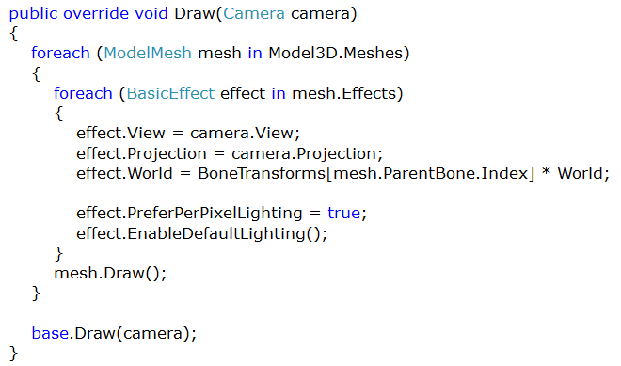
Model Drawing
To draw a model we need to
Loop through each mesh in the model
Set the parameters of the BasicEffect
Remember the Vertex shader needs the World, View and Projection
Draw each mesh
Send vertex data to the Graphics Device
Mesh.Draw()
There are a lot of settings available when drawing
EnablePerPixelLighting (Lighting done in the Pixel Shader)
FogEnabled
EnableDefaultLighting

Slide 14
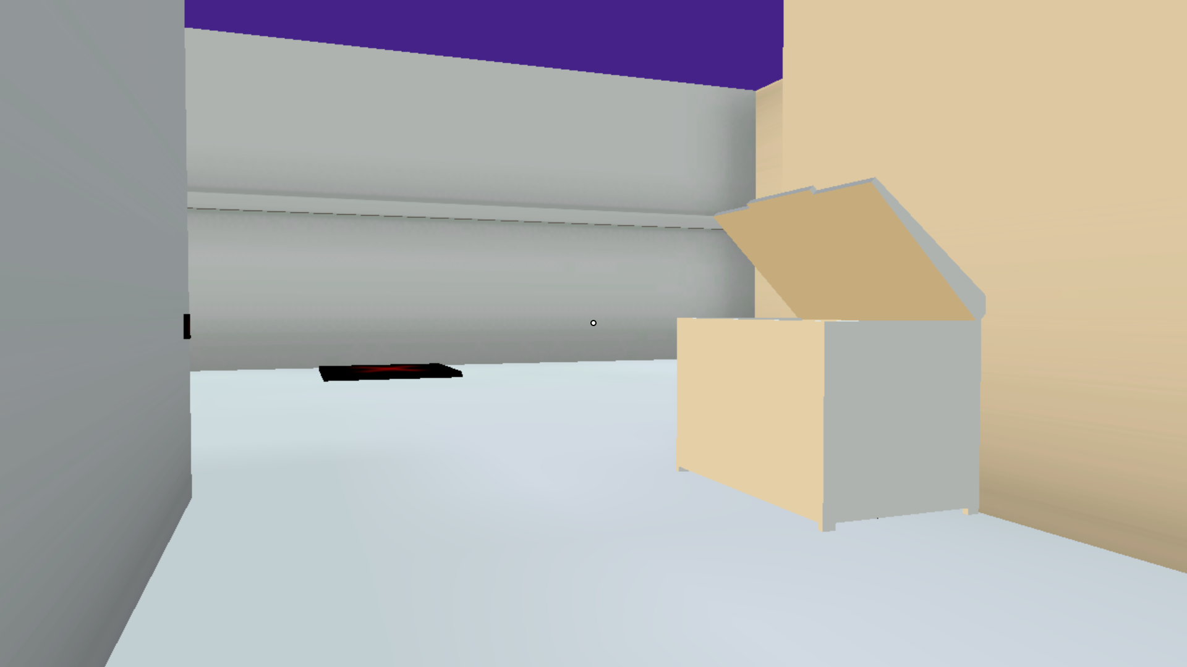
Model Drawing Sample

Slide 15
Model Notes
When adding a texture to your model in the 3D package
The location or folder placement cannot change after exporting the model
FBX stores where the Texture was picked from
When loading a model we do not need to load the texture
We don’t even need to add it to the content project
MonoGame automatically detects that a texture is applied
The model has it’s name and location
MonoGame uses this to build the texture along with the model
We can manually change the texture at runtime using BasicEffect.Texture

Slide 16
Model Data
Some of the data stored in a 3D is of high value to use for uses other than rendering
Bounding volumes for use in physics
The vertex data of a model is a key resource
We will cover two ways of extracting this data
Runtime extraction
Build time extraction (Content Processor)

